Slide 1
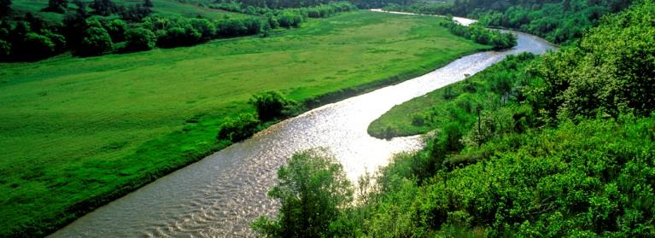
Incorporating the
9-Elements into a WMP
Lindsey Phillips Mike Archer
Source Water Coordinator State Lakes Coordinator
(402) 471-6988 (402) 471 - 4224
lindsey.phillips@nebraska.gov mike.archer@nebraska.gov

Slide 2
Typical Parts of a WMP
Introduction – description of area, climate, demographic information, economic value, history of area usage and previous efforts
Public Input /Outreach – how citizens were recruited to participate, ways public input was collected, activities to educate the public, how to promote behavior changes amongst the public/stakeholders
Partnerships – who will be involved with the implementation of this plan and technical/financial assistance
Timeline – milestones, scheduled events
Water Quality – pollutant sources, water quality standards, data availability and assessment, water quality summary
Project Goals / Objectives – load reductions and targets, BMPs, treatments
Project Monitoring / Evaluations – monitoring, evaluations criteria, QAPP

Slide 3
Introduction
description of area, climate, demographic information, economic value, history of area usage and previous efforts
EXAMPLE LAYOUT: Carter Lake
Project Description – Brief description of project area and why a watershed plan is necessary
Watershed Description -
  Topography – included map of area
  Geology / Hydrology
  Soils
  Climate
  Land Use – broke out into percentages
  Habitat inhabitants – endangered species

Slide 4
Public Input
This is the part of the planning process. Activities include: how citizens were recruited to participate, ways public input was collected, how was the information used
Public Outreach
This is the educational component of the plan. Activities include: focusing on educating the public, determining ways to engage the public’s interest, promoting behavior changes amongst the public/stakeholders

Slide 5
Public Input
EXAMPLE LAYOUT: Beaver Creek and Little Creek
Public meeting – inform public of goals and solicit participation
Developed working groups – target communities of people with common interests in the watershed
  Agricultural
  Residential / Urban
  Governmental
Developed a steering committee that had representation of all working groups
Use these meetings to develop implementation of the plan

Slide 6
Public Outreach
EXAMPLE LAYOUT: Carter Lake
A. What is the overall intention of the public outreach program (Information and Education)
  Goal 1 – Promote stewardship among users
    (List tasks that will accomplish this goal. Ideal tasks will be both challenging and specific )
    Task 1 – Develop a volunteer group to remove trash from local parks.
  Goal 2 – Promote the use of BMPs
    Task 2 – Provide free soil tests to homeowners to promote the usage of phosphorus free fertilizers
  Goal 3 – Provide updated information on project activities
    Task 3 – Use the local media to provide updates on the accomplishments and special events related to the project

Slide 7
Partnership
who will be involved with the implementation of this plan and technical/financial assistance
EXAMPLE LAYOUT: Wahoo
List all partners that will be assisting in financial and/or technical review.
For each partner provide a brief explanation of what role they play in the implementation of this plan.
*Plan sponsors should consider the use of federal, state, local, and private funds or resources
Provide an overall budget of major projects within the plan.
Provide any shortfalls in technical or financial assistance

Slide 8
Timeline
milestones, scheduled events
EXAMPLE LAYOUT: Narrative vs. Table
Both ways are acceptable, however the table version is sometimes easier to understand and can be used for a quick reference
Schedule – the schedule for implementing the management measures outlined in the watershed plan
    *should reflect milestones
Milestones – will measure the progress of implementing major projects in the plan
  Milestones need to be measureable and are considered provisional.

Slide 9
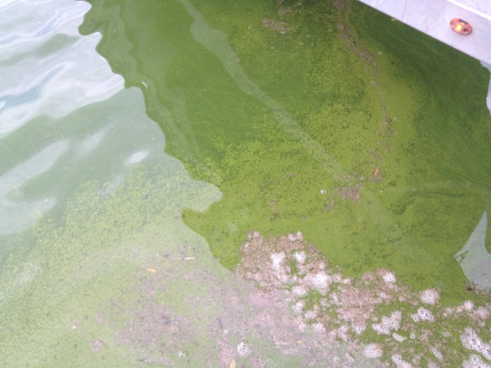
Water Quality
General Watershed Information
HUC Info
  List of 303d Streams and/or Lakes
  Results of Water Quality Monitoring
  TMDL?
Source of impairments are identified and described
  Point source
  Non-Point Source
Current Loading of Pollutants
Map

Slide 10
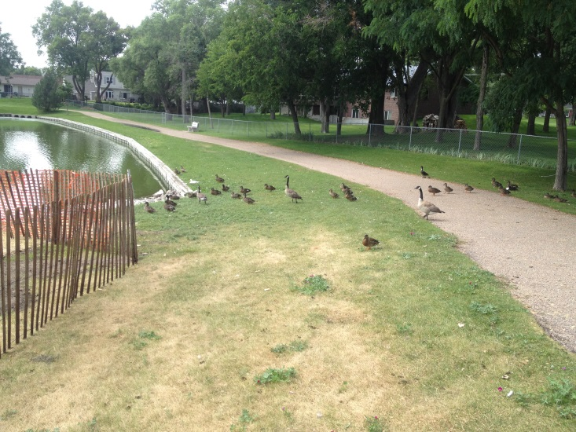
Project Goals
Expected Load Reductions
  What load reductions are needed to meet the designated uses?
    How were these reductions determined?
  What reductions are to be expected from implemented BMPs?
    Quantify Goals for Identified Sources
Best Management Practices (BMP)
  Identify Critical Areas (Map)
    Prioritize these areas
    What BMPs should be emphasized in each area
    Quantify projected BMPs
      Miles of terracing, number of grade stabilization structures, etc.

Slide 11
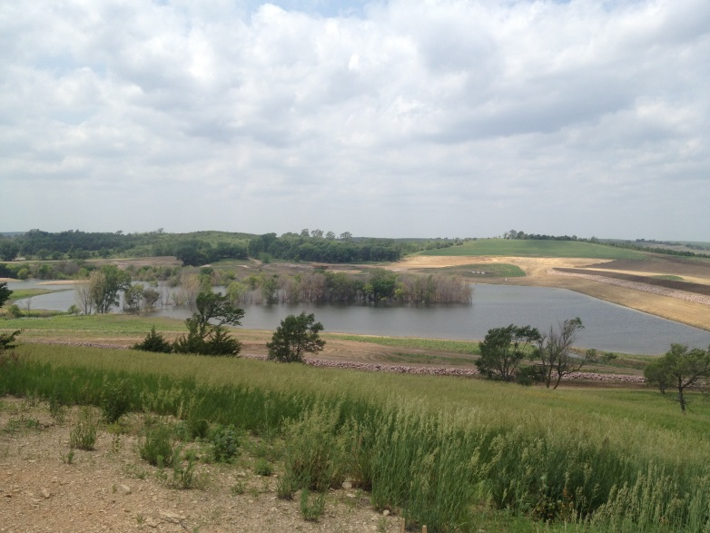
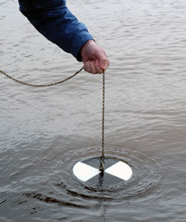
Project
Monitoring
What Are You Monitoring?
  Who is Responsible for Monitoring?
  Monitoring Schedule
  Sampling Design and Plan
    Will the Sampling Design Address the Effectiveness of Implemented BMPs?
  QAPP!!!
    Quality Assurance Project Plan
  Will the Area be Reassessed for 303d Considerations?

Slide 12
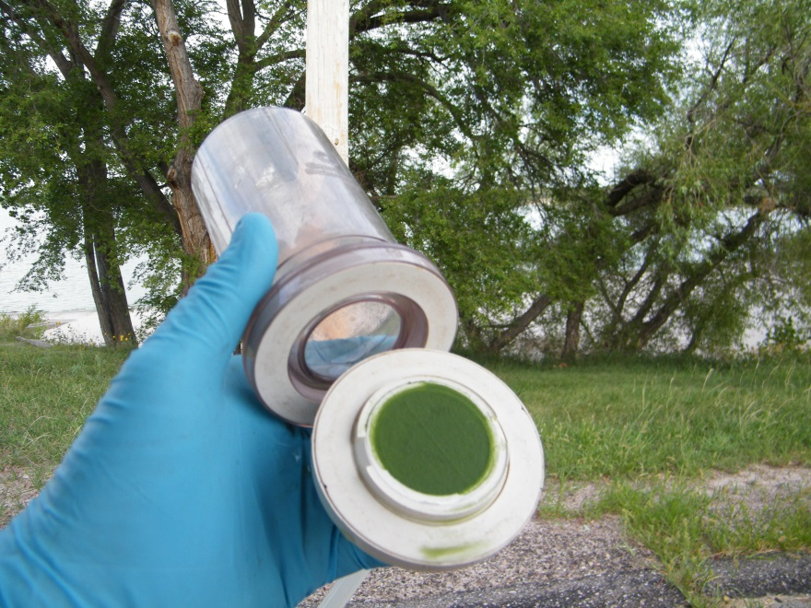
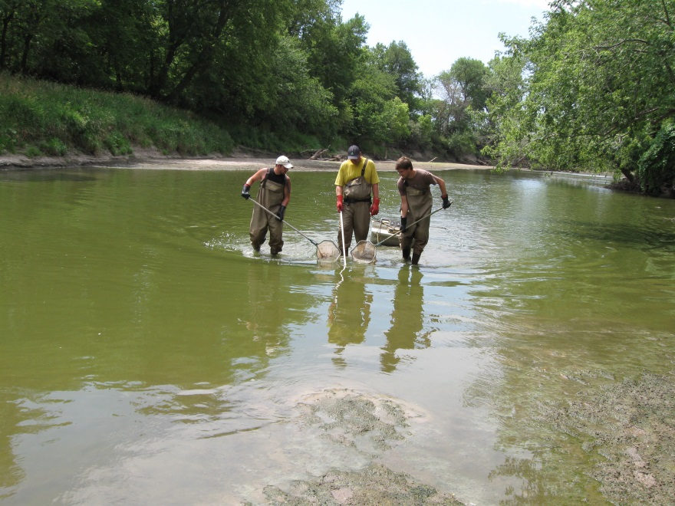
Project Evaluation
Evaluation of Load Reductions
  Interim Water Quality Milestones
    Reductions in Atrazine, E.coli, or Improved Bio Diversity
Adaptive Management

Slide 13
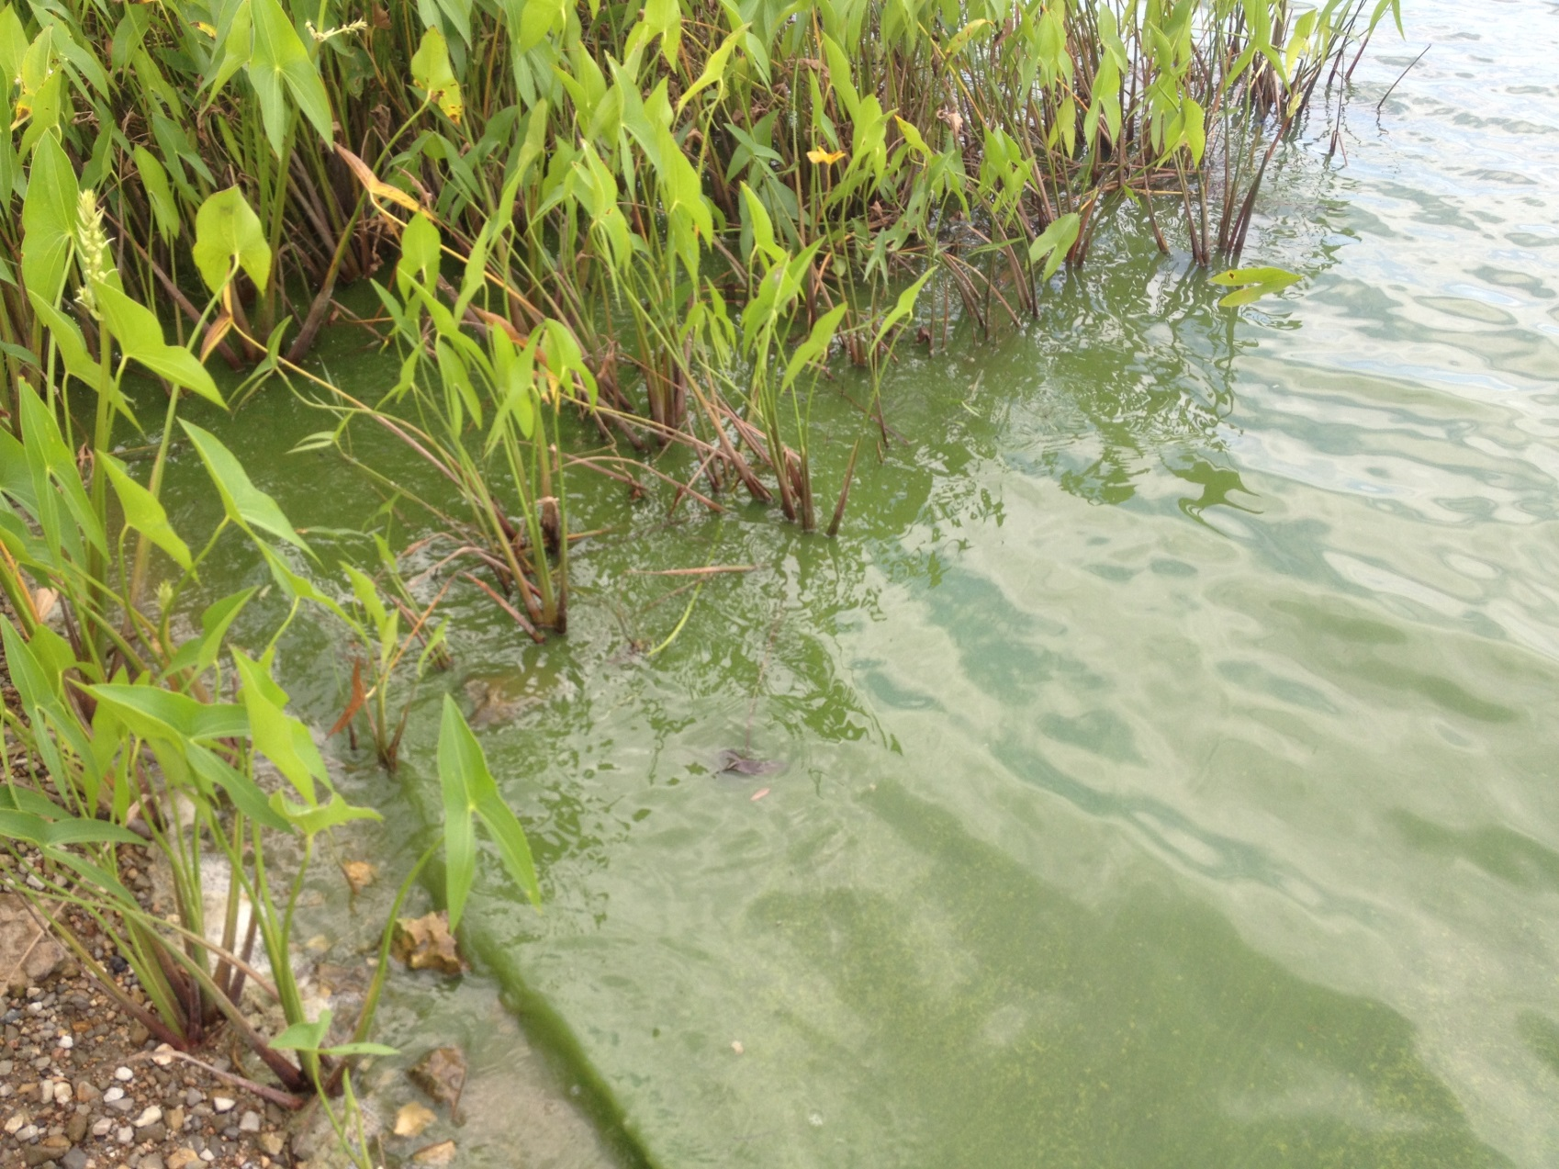
Thank You

