Slide 1
Components of every Good Watershed Management Plan
NDEQ – Planning Unit
August 6th, 2014 NDEQ – Planning Unit
gust 6th 2014

Slide 2
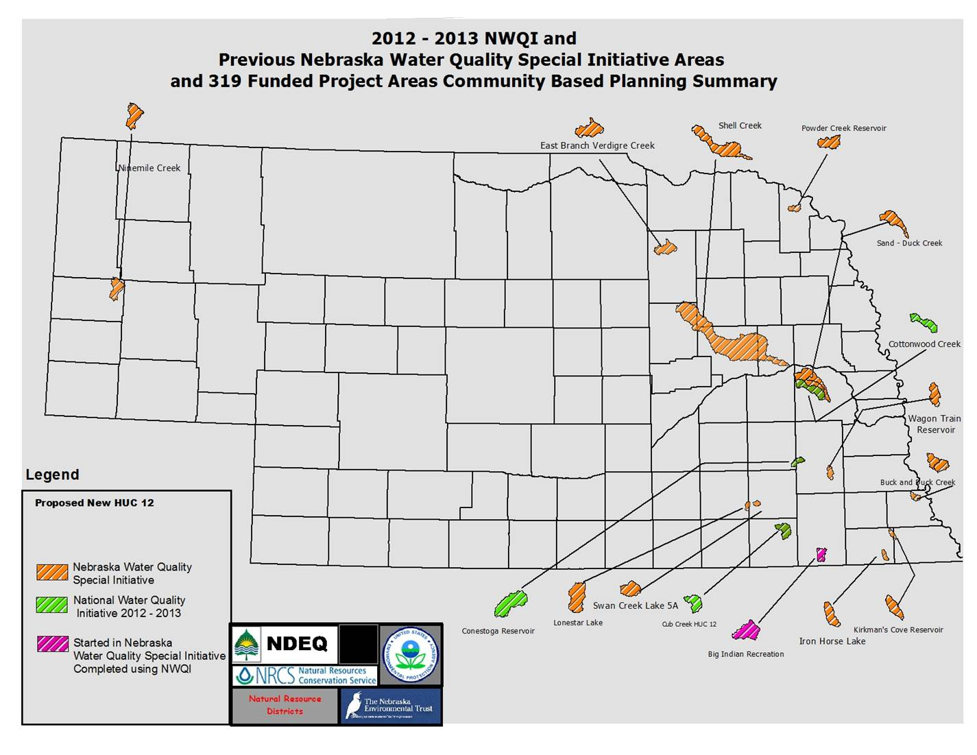
Approved Watershed Management Plans
As of August 6th 2014

Slide 3
Plan includes a simple cross-walk for each of the 9 Elements
Element | Location in Plan
Impairment causes & pollutant sources | Water Quality Concerns Section. Pages 21-28 Target Pollutants and Sources Section. Pages 29 - 36
Estimated load reductions needed | Pollutant Load Reduction Section. Pages 42 - 47
Management measures to achieve goals | Pollutant Load Reduction Section. Pages 42 - 47 Implementation Approach Section. Pages 48 - 52
An Information & Education component | Information, Education and Public Participation Section. Pages 59 - 61
Develop an implementable schedule | Schedule and Milestones Section. Pages 61- 62
Interim milestones to track BMP implementation | Schedule and Milestones Section. Pages 61 – 62
Evaluation Criteria to measure progress towards reaching goals | Monitoring and Evaluation Approach Section. Pages 52 - 58
Monitoring component | Monitoring and Evaluation Approach Section. Pages 52- 58 LBBNRD Four Year Monitoring Strategy – Stand-alone document that accompanies this plan.
Technical & financial resources needed for implementation | Budget And Resources Section. Pages 62 – 65
9
If you insert EPA’s 9 Element table then use a simple table or a marker.
Element | Page
A | 12
B | 16
C | 22

Slide 4
Watershed-based plan basics
Acknowledge political boundaries yet include geographic information for the entire watershed
Maps are provided as well as written descriptions, charts and tables
Discus how and where GW & SW interact
Utilize Integrated Report & Title 117 information

Slide 5
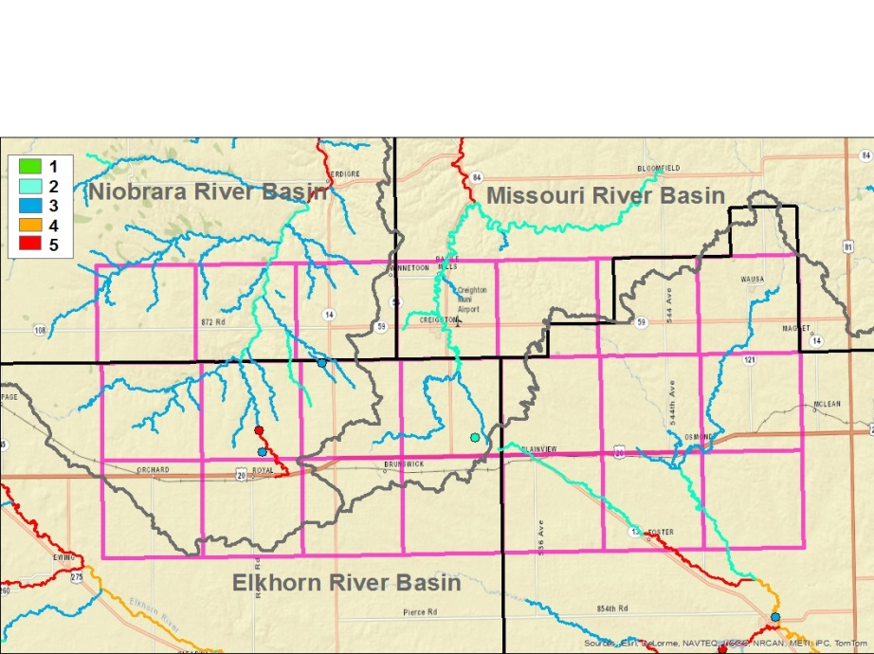
From T117 & IR to WMP
Waterbody ID | Waterbody Name | Recreation | Aquatic Life | Public Drinking Water Supply | Agriculture Water Supply | Industrial Water Supply | Aesthetics | Overall Assessment | 2014 IR | Impairments | Pollutants of Concern | Comments/ Actions
MT2-12400 | Bazile Creek | I | S |  | S |  | S | I | 5 | Recreation-Bacteria | E. coli | Aquatic community assessment, Fish consumption assessment
MT2-12410 | Lost Creek |  | NA |  | NA |  | NA |  | 3
MT2-12420 | Howe Creek |  | S |  | NA |  | S | S | 2 |  |  | Aquatic community assessment
MT2-12421 | Unnamed Creek |  | NA |  | NA |  | NA |  | 3

Slide 6
A. Causes of impairments and pollutant sources
Cause vs Source
Include TMDLs: LC, LR & WLAs
Analyze existing GW and SW data, provide formulas or models used & identify gaps
Provide priorities based on model results
List and Map sources
Impaired Reach | Facility Name | NPDES Permit # | Receiving Stream | Design Flow (cfs)
BB1-10000 | AURORA WWTF | NE0031810 | BB4-20900 | 0.464
 | BARNESTON WWTF | NE0121711 | BB1-10000 | 0.028
 | BEATRICE WWTF | NE0020915 | BB1-10000 | 2.558
 | BEAVER CROSSING WWTF | NE0023981 | BB3-10000 | 0.668
Notes:
NPS example, setback 30 ft on either side of a stream from a crop field

Slide 7
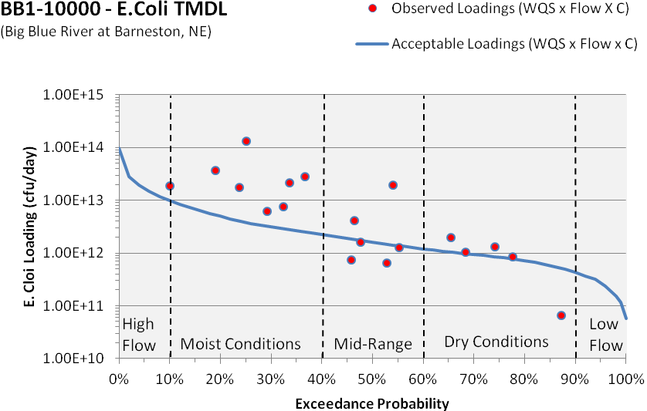
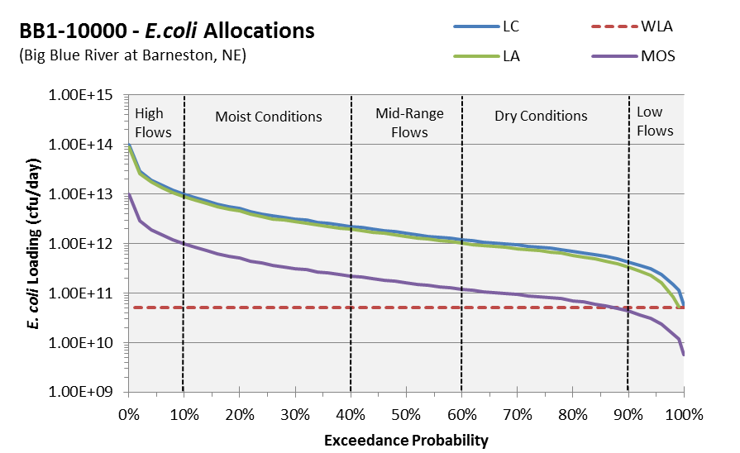
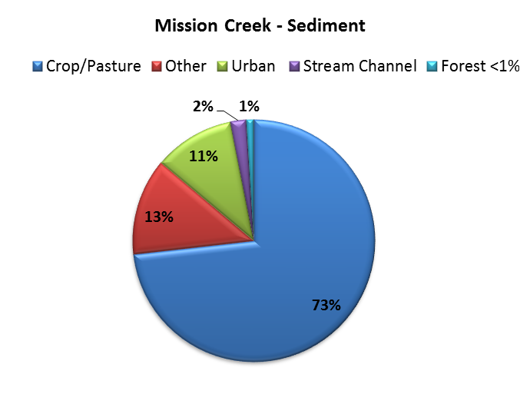
From TMDL to WMP
Impaired Segment | Waterbody Name | 2007 Seasonal Geometric Mean (#/100ml) | E. coli Above WQS (#100ml)
BB1-10000 | Big Blue River | 268 | 142
BB1-10100 | Mission Creek | 211 | 85
BB1-10800 | Big Indian Creek | 148 | 22
BB1-20000 | Big Blue River | 1414 | 1288
BB2-10000 | Turkey Creek | 1033 | 907
BB2-20000 | Turkey Creek | 1079 | 953
BB3-10000 | West Fork Big Blue River | 1699 | 1573
BB3-20000 | West Fork Big Blue River | 2019 | 1893
BB4-10000 | Big Blue River | 776 | 650
BB4-20000 | Big Blue River | 782 | 656
Percent Exceedance | Loading Capacity (cfu/day) | WLA (cfu/day) | LA (cfu/day) | MOS (cfu/day)
100% | 5.66E+10 | 5.17E+10 | 0.00E+00 | 5.66E+09
90% | 4.31E+11 | 5.17E+10 | 3.36E+11 | 4.31E+10
80% | 7.04E+11 | 5.17E+10 | 5.82E+11 | 7.04E+10
70% | 9.37E+11 | 5.17E+10 | 7.92E+11 | 9.37E+10
60% | 1.18E+12 | 5.17E+10 | 1.01E+12 | 1.18E+11
50% | 1.60E+12 | 5.17E+10 | 1.39E+12 | 1.60E+11
40% | 2.21E+12 | 5.17E+10 | 1.94E+12 | 2.21E+11
30% | 3.12E+12 | 5.17E+10 | 2.76E+12 | 3.12E+11
20% | 5.08E+12 | 5.17E+10 | 4.52E+12 | 5.08E+11
10% | 1.00E+13 | 5.17E+10 | 8.95E+12 | 1.00E+12
0% | 9.75E+13 | 5.17E+10 | 8.77E+13 | 9.75E+12
Title 117 – Stream Segment Number(s) | BB1-10100, 10200
Beneficial Use Status | 10100-Impaired, 10200 Not Assessed
Reach Length (miles) | 16.0
Drainage Area (acres) | 35,227
Stream Flow (ft³/sec.) | 26.1
Total Nitrogen Load (lbs/yr) | 164,813
Total Phosphorus Load (lbs/yr) | 80,072
Total Sediment Load (t/yr) | 80,766

Slide 8
B. Estimated pollutant loadings and BMP load reductions
Short term goals should be achievable at the project level
Long term load reductions are sufficient to meet T117 designated uses
Modeling limitations, data sources and processes are discussed & verifiable
Notes:
Short term goals = reduce pollutant by X units
Long term = meet QWS and restore stream segment LP1-10000

Slide 9
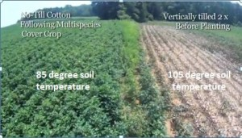
C. Management Measures
Plan includes both structural and non-structural measures
Priority areas are ranked and mapped
The rationale for choosing measures is described
Adaptive management process is on place to evaluate effectiveness of management measures

Slide 10
D. Technical & Financial Needs
This is a critical factor in turning this plan into a reality
All types of funding and technical assistance should be considered
Administration services (salaries, regulatory fees, supplies)
Information/education efforts
Installation, operation, and maintenance of BMPs
Monitoring, data analysis, and data management activities
Notes:
Table is an example of a BMP budget analysis taken from Walnut Creek Management Plan

Slide 11
E. Information & Education
Define information/education goals
Identify and analyze the target audiences
Create the messages for each audience
Package the message for the various audiences
Distribute the messages
Evaluate the information/education program

Slide 12
F. Implementation Schedule
Where goals and objectives become individual tasks
Should include a timeline for phases and steps
Include who is responsible for implementing the activity
Break the work down into reasonable tasks that can be tracked and reviewed

Slide 13
G. Interim milestones
Milestones help measure the implementation of activities in the plan
Example: Short–Term (< 2 years)
Mid-Term (< 5 years)
Long-Term (5 years or longer)

Slide 14
H. Plan evaluation criteria
Inputs – the elements of the process used to implement your program
Outputs – the tasks conducted and the products developed
Outcomes – the results or outcomes realized from implementation efforts

Slide 15
I. Monitoring implementation effectiveness over time
This can track progress in meeting load reduction goals and attaining water quality standards
Measurable progress is critical for the support of watershed projects
Progress is best demonstrated with the use of monitoring data that reflects water quality conditions
Baseline (Before)
Project-specific (During)
Post-project (After)

