Slide 1
Should you have an EH&S Management System?
Why on earth would you want another system to manage?
NDEQ – 2015 Environmental Update – Ethanol Workshops
Aaron Martinkus
EH&S Consultant

Slide 2







Examples of Management Systems

Slide 3
So Really….Why?
Requires management support, buy-in, and periodic review
Provides more clear expectations for all levels of the organization
Ability to link all regulatory compliance into one “system”
Often times, and likely more so in the future, customers will require you to!
Continuous improvement
Lower incident rates
Increased employee morale
Improved regulatory and community reputation
All these things lead to an effective EH&S Management System being a potentially large improvement to the bottom line

Slide 4
Examples

Slide 5
Examples

Slide 6
Examples

Slide 7
Examples

Slide 8
Examples

Slide 9
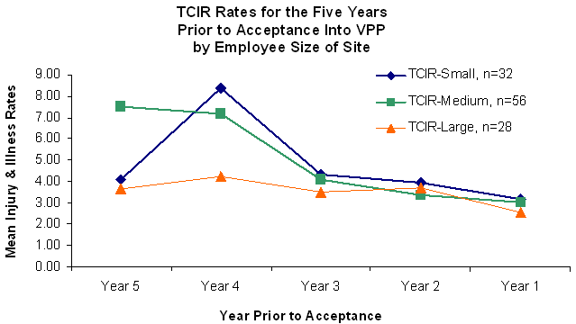
Examples

Slide 10
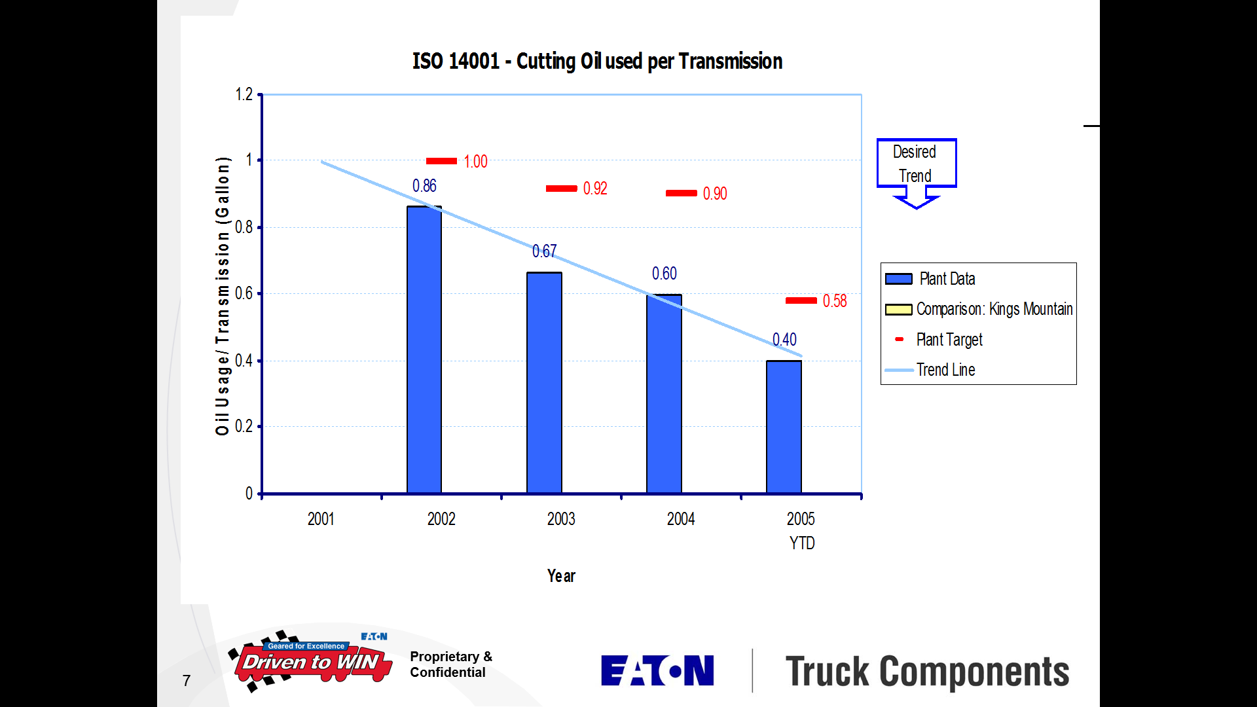
Examples

Slide 11
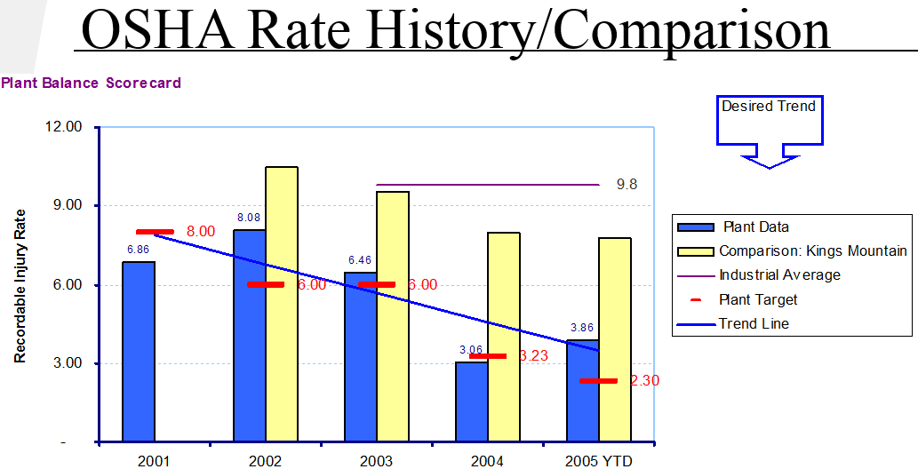
Examples

Slide 12
What Would It Look Like?
Determine EH&S Requirements
Define Roles & Responsibilities
Complete Emergency Planning
Review Data & Metrics
Review Change Management
Complete EH&S Risk Assessment
Set Relevant Targets & Goals
Create Consolidated Management Plan
Establish EH&S Measures
Deploy Management Plan
Create and Utilize Cross Functional
EH&S Personnel
Implement Core Management and
Regulatory Requirements
Establish & Determine EH&S Training
Matrix
Establish EH&S Communication Plan
Create Relevant Documentation
Establish Operational Controls
PLAN
DO
ADJUST
CHECK
Establish EH&S Performance Metrics
Track Action Plans to Closure
Track & Report Metrics
Conduct Management Reviews
Identify Opportunities for Improvement
Review Performance against Goals
Establish Monitoring & Measuring Process to Ensure Control of EH&S Impacts & Risks
Evaluate Compliance (Legal | Area Inspections | Emergency Drills | Internal & 3rd Party Assessments)
Establish Action Plans

Slide 13
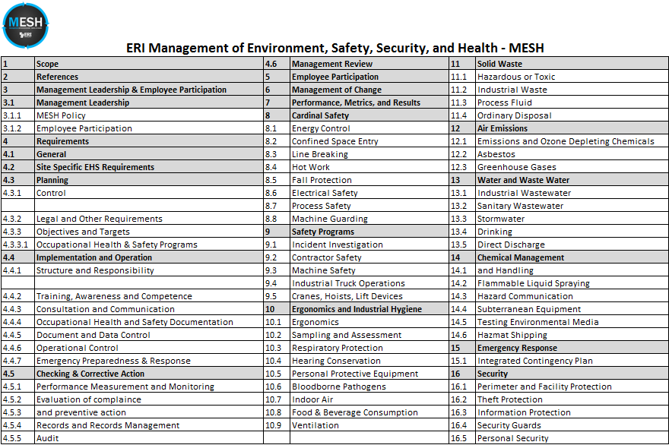
What Could It Look Like?

Slide 14
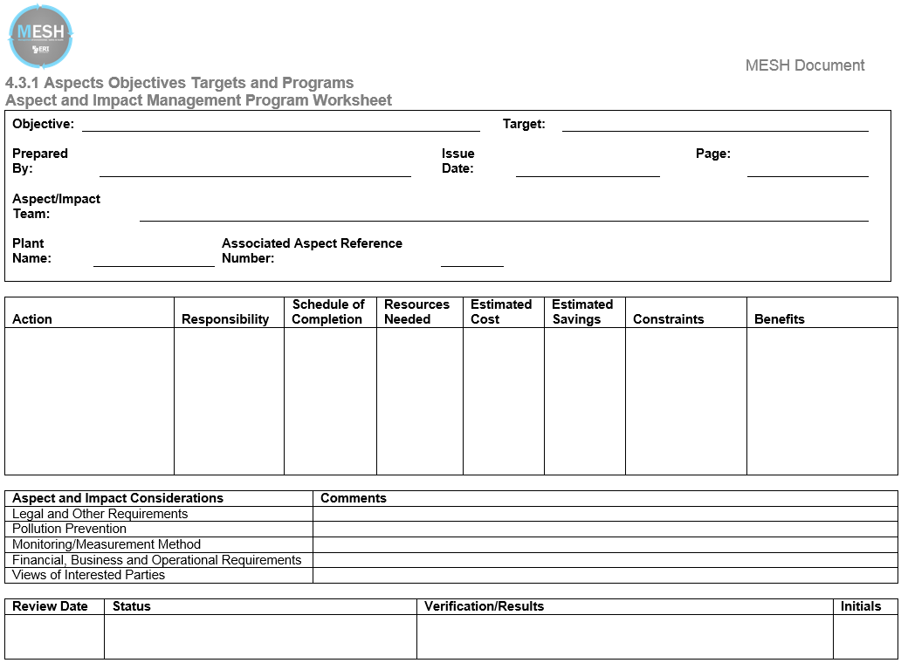
Potential Tools

Slide 15
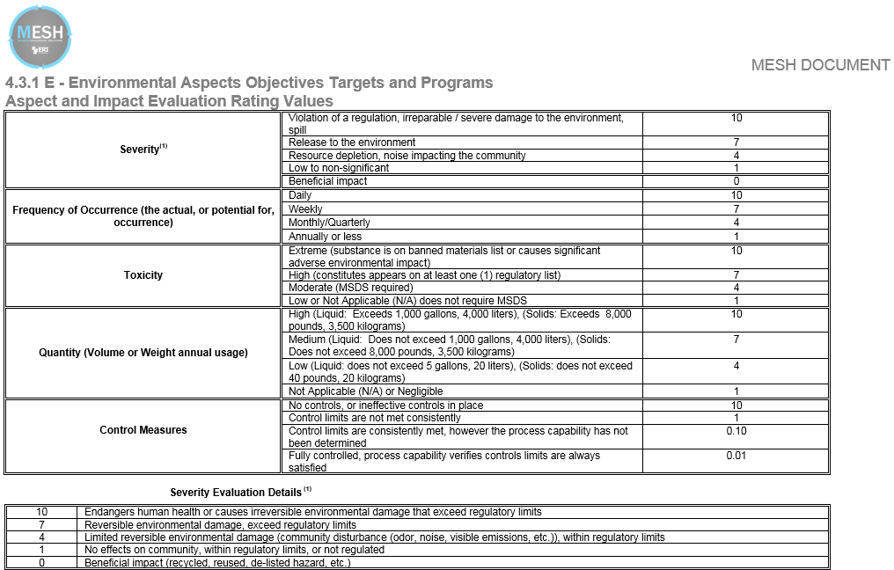
Potential Tools

Slide 16
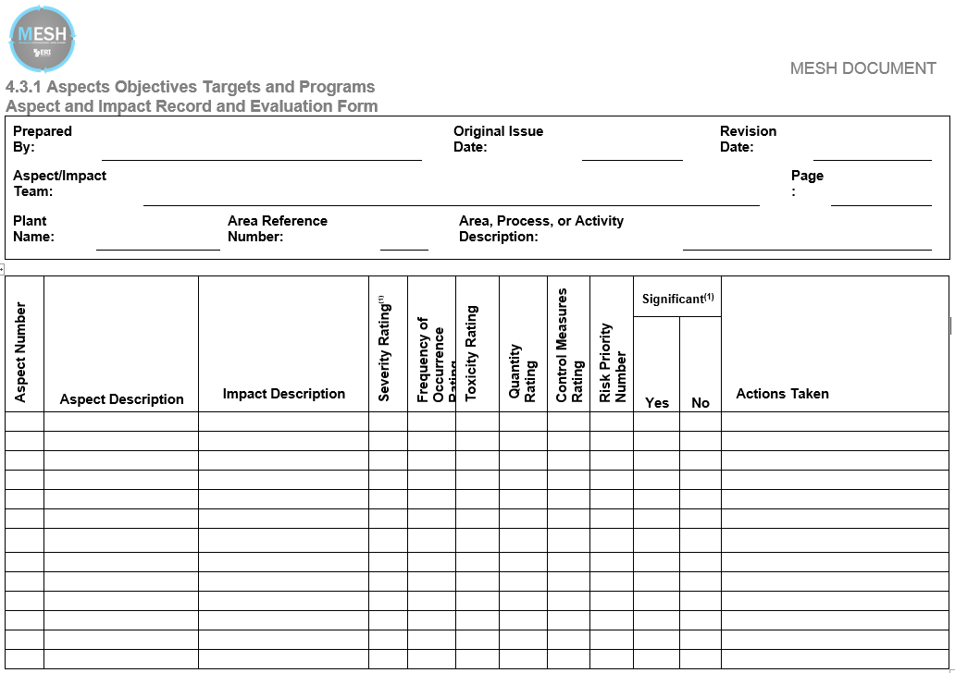
Potential Tools

Slide 17
Potential Tools

Slide 18
Potential Tools

Slide 19
Sold?
Would a structured system help you (the EH&S Manager) manage the system and ensure engagement from top to bottom?
Would periodic management review of pre-determined metrics with respect to pre-determined goals help you be more successful in your role?
Would the challenge of continually improving your passion (EH&S hopefully) keep you more engaged and excited to come to work every day?
Would your boss appreciate when you can show trends such as we’ve shared today that will directly affect your shareholders’ returns?
Don’t wait – Get Started TODAY!

Slide 20
How Do You Get There?
Line Management of EH&S
Employee Involvement in EH&S Activities
EH&S Friendly Equipment & Conditions
Management Commitment, Vision, and Drive
World Class EH&S
Comprehensive EH&S Systems & Practices
Engaged Employees & Committed Workforce
EH&S Committees and Specialists

Slide 21
Ask Yourself – Where Do We Stand?
Maybe ask your hourly employees and management team where they think you stand
  If you do a survey, consider an anonymous, repeatable, measurable survey – www.surveymonkey.com
  Use your peers both within and outside your industry for benchmarking – no need to reinvent the wheel
Where do you go from where you’re at?
  Continuous improvement toward the big picture goal
  Set goals and evaluate your achievement of goals
  Define shortcomings and develop corrective actions
  Act on those corrective actions
  Repeat – over and over and over again – it’s not a short journey

Slide 22
Coming Soon to a Webinar Near You
EHS Culture Surveys – coming again soon to many of you
  What does the survey tell me?
First steps (albeit baby steps) but the first steps to World Class EH&S
Webinar series to continue for taking your facility to the goal destination
  Using tools familiar to Lean/Six Sigma practices to help drive your regulatory compliance to world class status
  Collection and communication of peer data within the ERI group to benchmark yourself against

Slide 23


Destination
EH&S

